Slide 1
Agenda
Administrative
Creating a Project Management Plan

Slide 2
Creating the Project Management Plan
Initiating
Planning
Executing
Monitoring and Controlling
Closing

Slide 3
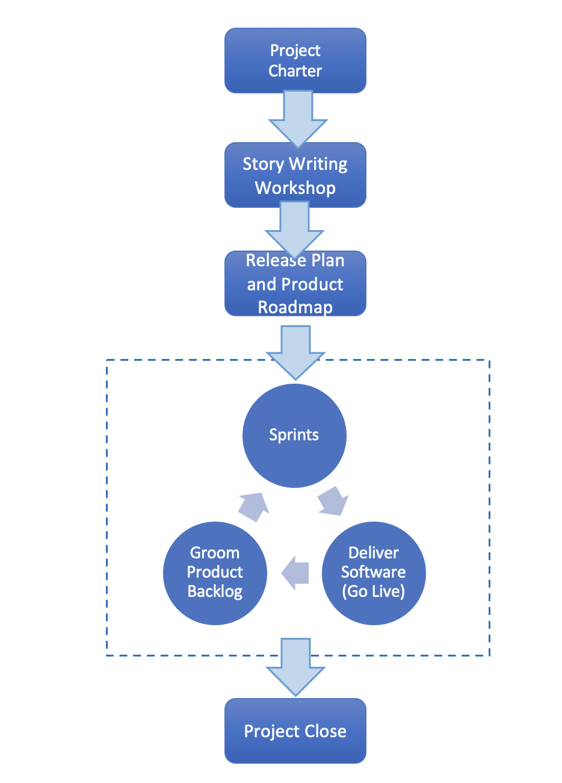
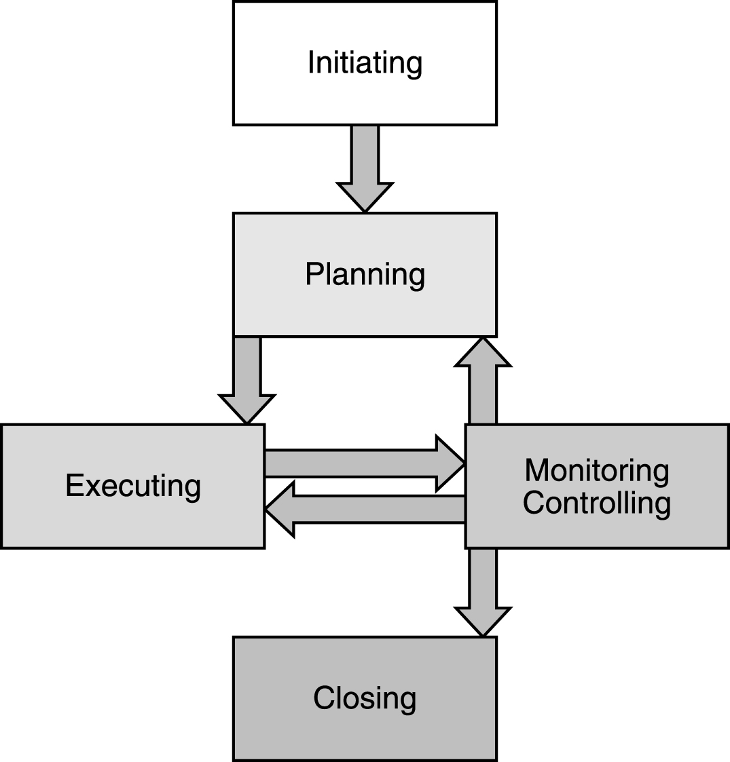
Understanding the Project Lifecycle
Planned – PMBOK
Adaptive - Scrum/Agile
PMP in Depth: Project Management Professional Study Guide for PMP and CAPM Exams

Slide 4
The Project Management Plan
Varies according to project need
Systems Development Lifecycle
Processes
Complexity
Formally Controlled
Document revision process
Document revision history
Single Document or Document Collection
Scrum Uses a Product Roadmap, Release Plan and Sprint Backlogs Instead of a formal, detailed Project Management Plan

Slide 5
Project Planning – Planned Approach
Project Consists of Two Main Components
The project work that needs to be performed
The schedule to perform the work
Goal of planning is to identify all activities that need to be performed, who will perform each activity, how long each activity will take, and when the activities will be performed over the life of the project.
Detailed plan covering all project tasks required to produce the deliverables

Slide 6
The Project Work – Detailed Scope Project Scope

Slide 7
Detailed Project Scope Statement Components
Project Objectives
Business, technical, quality, schedule
Project Deliverables
Unique verifiable product, a capability to provide a service, or a result that must be produced to complete a project, a process, or a phase of the project
Project Requirements
Requirements on deliverables
Approval Requirements
Configuration Management Requirements

Slide 8
Detailed Project Scope Statement Components – Cont’d
Project Boundaries
Specify what is included and what is not (e.g. is/is not technique)
Product (Process) Description
Product scope description defining the features of the product
Process and criteria for accepting the completed project
Initial Project Team
Names and roles of project team members
Scheduled Milestones
Notes:
Question: what is the difference between an objective, a deliverable and a requirement?

Slide 9
Detailed Project Scope Statement Components – Cont’d
Cost Estimate
Project Assumptions and Constraints
Quality, Resources, Scope, and Time
Initial Risk Identification

Slide 10
Detailed Project Scope Exercise
You are working for We Are Big, Inc. , an international firm with over 100,000 employees located in several different countries. A strategic goal is to help improve the environment while increasing revenues and reducing costs. The Environmental Technologies Program just started, and the VP of Operations, Natalie, is the program sponsor. Ito is the program manager, and there is a steering committee made up of ten senior executives, including Natalie, overseeing the program. There are several projects underneath this program, one being the Green Computing Research Project. The CIO and project sponsor, Ben, has given this project high priority and plans to hold special interviews to handpick the project manager and team. Ben is also a member of the program steering committee. Before coming to We Are Big Inc., Ben sponsored a project at a large computer firm to improve data center efficiency. This project, however, is much broader than that one was. The main purpose of the Green Computing Research Project is to research possible applications of green computing including:
Data center and overall energy efficiency
The disposal of electronic wasted and recycling
Telecommuting
Virtualization of server resources
Thin client solutions
Use of open source software, and
Development of new software to address green computing for internal use and potential sale to other organizations.
The budget for the project is $500,000 and the goal is to provide an extensive report, including detailed financial analysis and recommendations on what green computing technologies to implement. Ben decided to have a small group of people, five to be exact, dedicated to working on this six-month project full-time and to call on people in other areas on an as needed basis. Prepare a detailed project scope statement for the Green Computing Research Project. Assume the project will take six months to complete and the budget is $500,000.
Source: Information Technology and Project Management, Schwalbe

Slide 11
The Project Work - The Work Breakdown Structure

Slide 12
Work Breakdown Structure
A deliverable-oriented hierarchical decomposition of the work that must be performed to accomplish the objectives and create the deliverables of the project

Slide 13
Steps for Decomposition
Identify the deliverables and the work involved by analyzing the project
Select systems development life cycle model (SDLC)
Waterfall, Scrum, Prototyping, V-shaped, RAD, Spiral, Incremental, etc.
Map life cycle process activities to SDLC using available standards and guidelines such as SWE BOK
Requirements Definition, Design, Construction, Testing and Integration, Delivery
Structure and organize the first level
Decompose the upper level into more detailed components
Keep decomposing to lower levels until necessary and sufficient decomposition has been achieved
Assign identification codes to the WBS components

Slide 14
Waterfall Work Breakdown Structure (WBS)
^{Requirements Definition}
^{Design}
^{Develop Customer Requirements}
^{Develop Product Requirements}
Analyze and Validate Requirements
^{Web Application Project}
Stakeholder Interview Transcripts
Map Requirements to Product Components
^{Use Cases}
^{Stakeholder Requirements}
^{Data Flow Diagrams}
^{Validated Requirements}
Blue = Project
Red = WBS
Green = Work Packages
Gold = Activities

Slide 15
WBS Terminology
Work packages are made up of activities
Elements of work performed during the course of a project
Lowest level defined in the project management plan
Activities typically have an expected duration, an expected cost, and expected resource requirements
Activities depend on SDLC
Map systems development activities to WBS Structure
Sequencing
A task is a generic term for work that is not included in the WBS
Further decomposition of work by the individuals responsible for the work
A milestone is a significant event in the project usually associated with a major work product or deliverable

Slide 16
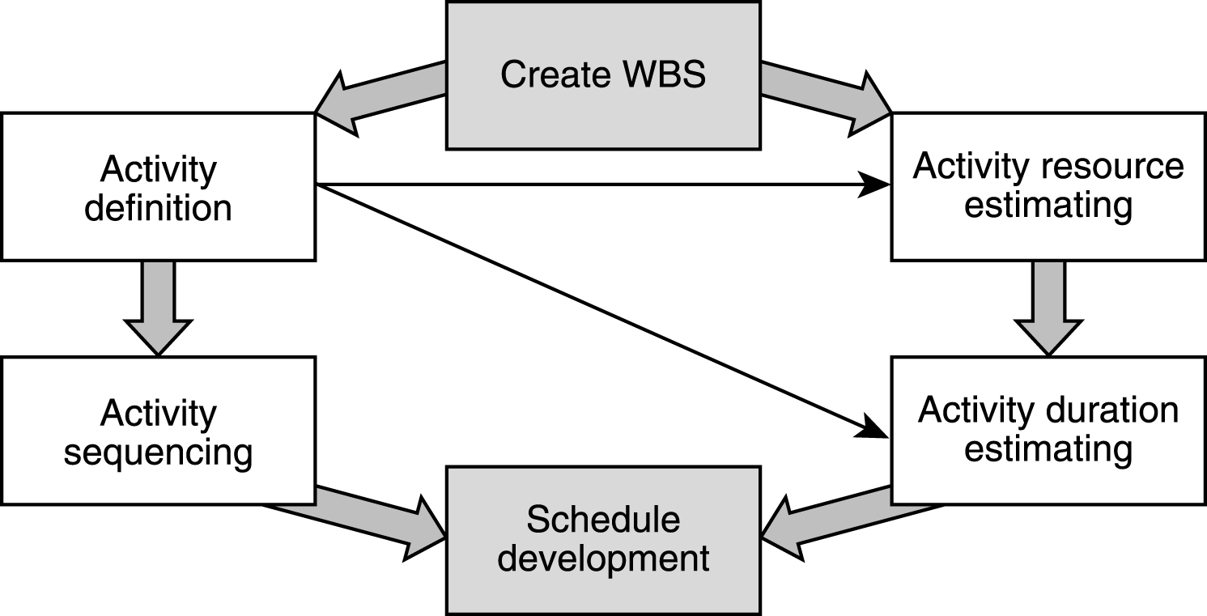
The Big Picture
Notes:
Activity Definition
- Identifies the specific schedule activities that must be performed to produce product deliverables
Activity Sequencing
Identifies dependencies among the scheduled activities and orders activities accordingly
Activity Resource Estimating
Estimates the types and amounts of resources that will be required to perform each schedule activity
Activity Duration Estimating
Estimates the time in work periods (e.g. person-hours) individually for each schedule activity
Schedule Development
Helps create project schedule by analyzing activity sequences, schedule activity durations, resource requirements, and schedule constraints

Slide 17
Developing the Project Schedule – Activity Sequencing

Slide 18
Activity Sequencing
Identifies the dependencies among the schedule activities and orders the activities accordingly
A task has a dependency if it involves an activity, resource or work product which is subsequently required by another task
Tasks may have dependencies because they require the same resource
A
B
Activity A is a predecessor of activity B
Activity B is a successor of activity A

Slide 19
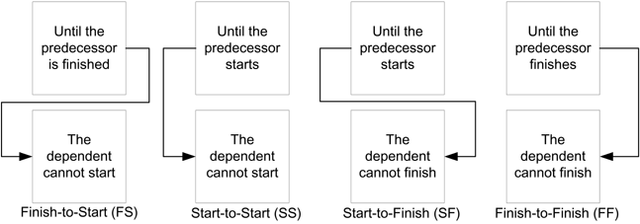
Precedence Relationships

Slide 20
Three Types of Dependencies
Mandatory Dependencies
Inherent to the schedule activities (e.g. software must be developed before it can be tested)
Discretionary Dependencies
Dependencies at the discretion of the project team (e.g. acceptance test with marketing before accounting)
External Dependencies
Involves a relationship between a project activity and a non-project activity (e.g. Windows xx Delivered)

Slide 21
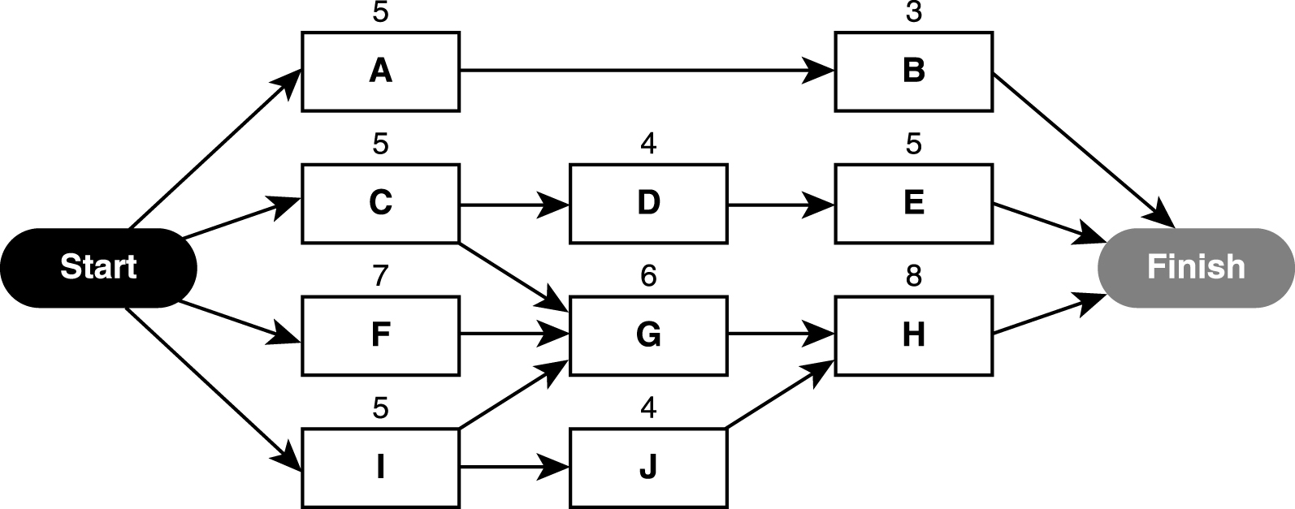
Project Schedule Network Diagram Precedence Diagramming Method (PDM)

Slide 22
Project Network Terminology
Critical Path
The longest path (sequence of activities) in a project schedule network
Early Start
The earliest an activity can start. It is the largest early finish time of all its immediate predecessors.
Early Finish
The earliest an activity can finish if all its preceding activities are finished by their early finish times
Late Start
The latest an activity can start and not delay a succeeding activity
Late Finish
The latest an activity can finish and not delay a succeeding activity
Float Time (Slack)
Time an activity can be delayed and not become critical

Slide 23
Project Network Calculations
Early Start and Early Finish
Forward Pass Through the Network
Late Start and Late Finish
Backward Pass through the Network
Slack or Float
Late Start – Early Start

Slide 24
Schedule Network Analysis
Critical Path Method
Used to identify the schedule flexibility
The critical path is the longest path (sequence of activities) in a project schedule network diagram
Determines the length of the project

Slide 25
Exercise
Activity | Time (Days) | Immediate Predecessors
A | 1 | -
B | 4 | A
C | 3 | A
D | 7 | A
E | 6 | B
F | 2 | C, D
G | 7 | E, F
H | 9 | D
I | 4 | G, H
Draw the critical path diagram
Show the early start, early finish, late start and late finish times.
Show the critical path.
What would happen if activity F was revised to take four days instead of two?
What would happen if activity D was revised to take zero days instead of 7?

Slide 26
Exercise
4
6
9
6
8
5
Identify the ES, EF, LS, and LF for all activities.
Identify the critical path.
What is the float for activity G?
What is the duration of the critical path?
What is the early start of activity G?
Notes:
Answers may be found on page 130 of PMP in Depth

Slide 27
Schedule Network Analysis
Resource Leveling
Involves taking a part of the resources from one activity and assigning it to another
Change the durations and possible the critical path
What if Scenario analysis
Calculate the effects of a specific scenario on the project schedule

Slide 28
Schedule Compression
Reduce Scope
Change the amount of work to be performed
Add Resources
Easy to do before the project starts, more difficult to do after project is underway
Revisit dependencies
If possible, perform additional tasks in parallel
Change Work Hours
Work overtime e.g. mandatory weekends, extended work days, etc.

